Slide 1


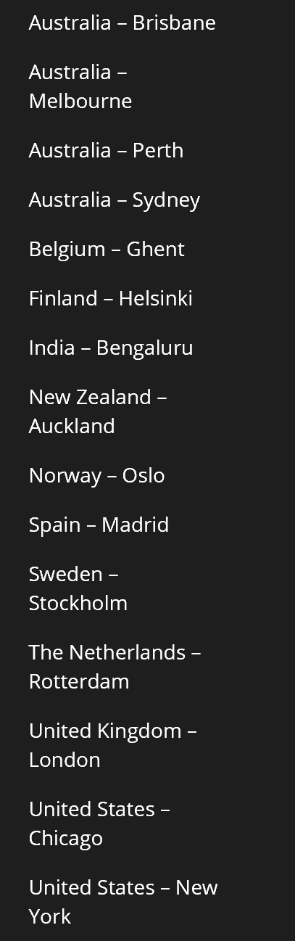
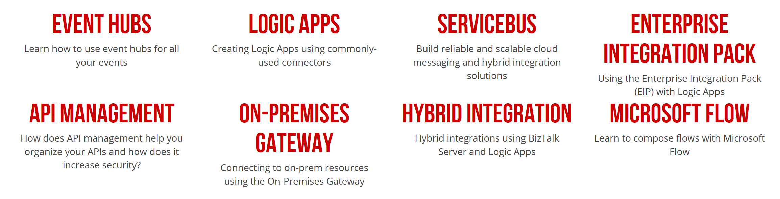

Slide 2








Global Organizers
Martin Abbott
Glenn Colpaert
Steef-Jan Wiggers
Tomasso Groenendijk
Eldert Grootenboer
Sven Van den brande
Gijs in ‘t Veld
Rob Fox

Slide 3

Azure Integration
State of the Union
Martin Abbott
@martinabbott

Slide 4

Who am I?
Microsoft Azure MVP
Organiser of Perth MS Cloud Computing User Group
Global Admin of Global Azure Bootcamp
Global Admin of Global Integration Bootcamp
Admin of Integration Down Under
Co-author of “Robust Cloud Integration with Azure”
@martinabbott

Slide 5


Azure Integration Services
Hybrid
API First
Connect Everything
Gain Insights
Enterprise Messaging
API MGT
AZURE SERVICES
CONNECTORS
MESSAGING
Logic Apps
BizTalk Server
Integration Evolved.

Slide 6

Utilise Serverless Technology
Reduced DevOps
Faster Time To Market
Micro-billing
{ }
$
$
Event-driven scale
Abstraction of servers
Rapid
development
Focus on business logic
Per action
billing
Reduce
costs

Slide 7
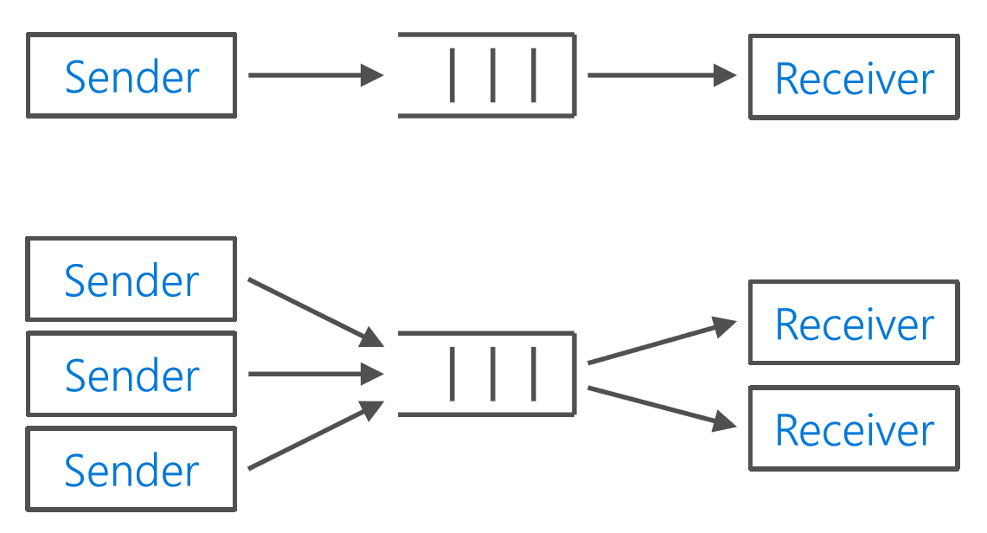
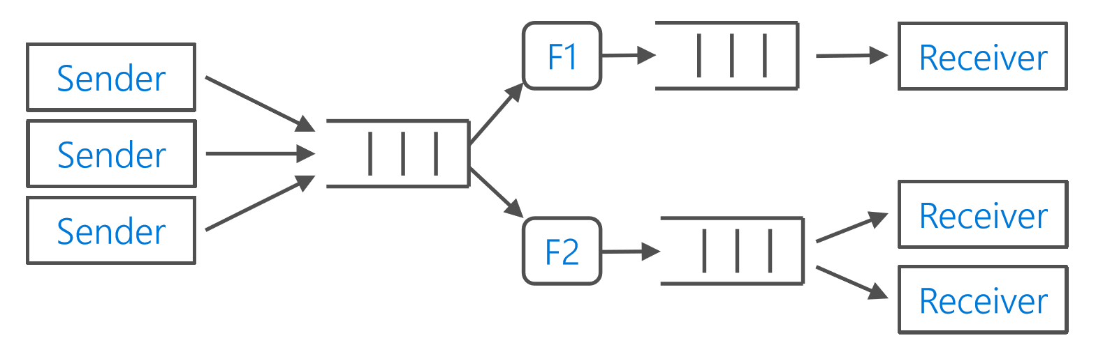
Service Bus Messaging
Queues
Traditional messaging
Deadlettering
Auto-forward
Peek Lock
Topics/Subscriptions
Fan in/out
Simple filters
Publish/subscribe semantics

Slide 8

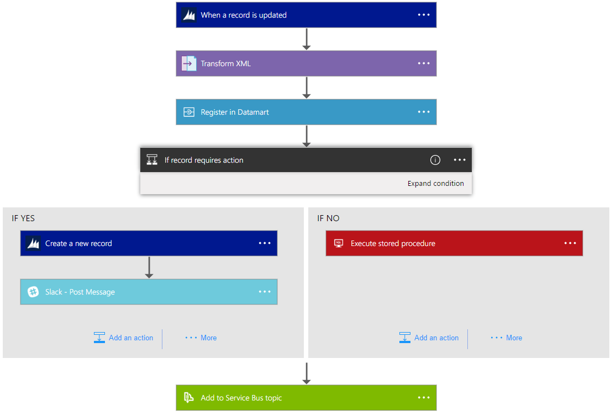
Logic Apps
Faster integration using innovative Visual Designer
Easy workflow creation with triggers and actions
Mashup applications, data and services
Built for mission critical Enterprise Integration
Create, deploy, manage and monitor

Slide 9





















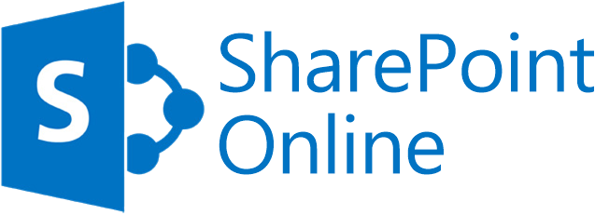






Connect SaaS
Azure API Management
Leverage Azure
Azure Service Bus and Event Grid
Azure Functions
Connect LOB
Azure Active Directory
Azure App Services
Azure Blob
Azure CosmosDB
Azure Data Lake
Azure SQL
Azure Resource Manager
Logic Apps
Gain Insights
On-premises data gateway
BizTalk Server

Slide 10









Azure Functions
Events
Code
Outputs
React to timers, HTTP, or events from your favorite Azure services, with more on the way
Author functions in C#, F#, Node.JS, Java, and more
Send results to an ever-growing collection of services

Slide 11

Azure Functions Proxy
Function app B
/products
Function2
Function app A
/customers
Function1
/products
Function app C
/orders
/orders
Function3
Key:
HttpTrigger function endpoints
API proxy endpoints

Slide 12
What’s in common?
Internet
of
Things
Machine
Learning
Mobile
APIs
Software
as a
Service
Cloud
Computing
Blockchain

Slide 13









API Management - a hub for enterprise APIs
Discover
Learn
On-board
Try
Get support
SDKs and samples
1st and 3rd party apps
Abstract
Secure & protect
Evolve
Monitor
Analyze
Productize
Monetize
Consume
Mediate
Publish
Developer portal
Gateway
Azure portal
API managers and developers
App developers
APIs on Azure and outside

Slide 14
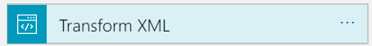
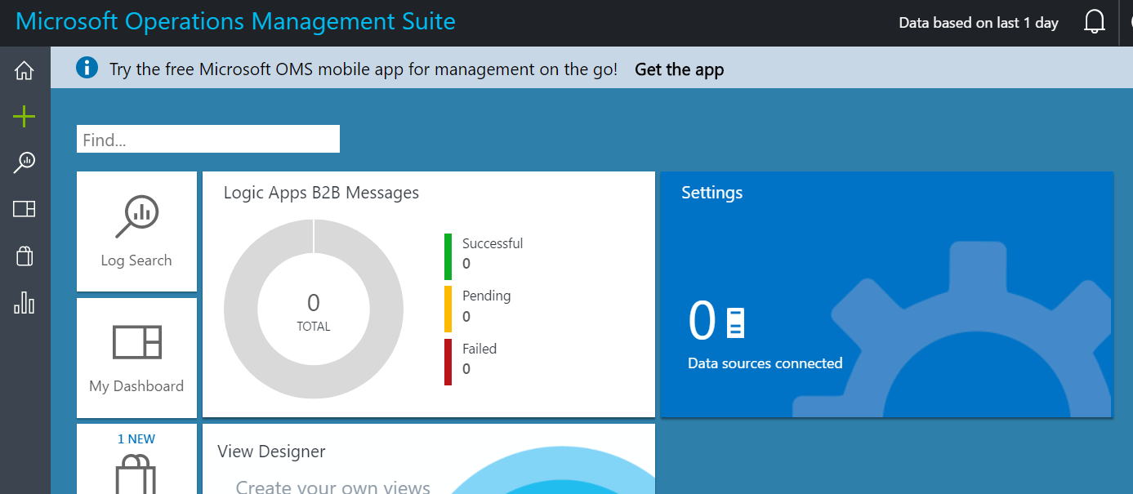
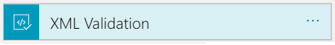

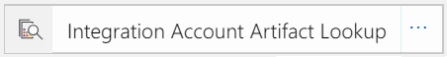

Integration Account
Core to XML and B2B capabilities
Partner creation and management
XML validation, mapping, flat file conversion
Tracking

Slide 15
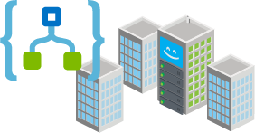
XML Messaging and B2B
Integration Account
Extensible for including Entity Metadata
EDI
XML & Flat file Processing
Portal and API based TPM
X12 Encode and Decode
XML Validation
XSLT Transformation
Convert flat files e.g. CSV to and from XML and convert between JSON and XML
EDIFACT Encode and Decode
Integration Account entity look up
Partner resolution
XPath support
AS2 Encode and Decode

Slide 16


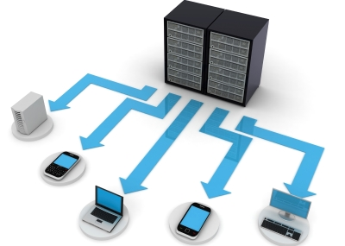
BizTalk Server
Service Bus
Azure WCF Relay
App Services / API Management
Logic Apps

Slide 17

Service Bus – SB-Messaging
Inbound and Outbound (One Way)
Queues and Topics
Security – ACS and SAS
Send | Listen permissions
Properties Propagation
Custom property schema

Slide 18
WCF Relay – WCF-BasicHttpRelay
Inbound and Outbound (Two Way)
Expose and Consume WCF Services
Based on dynamic Relays
Primed for XML
“Binary” format for others
Security – ACS and SAS
Send | Listen permissions
End-point security
Anonymous | RelayAccessToken

Slide 19
REST – WCF-WebHttp (Inbound)
Exposes REST Services
One or Two Way
Support multiple formats
Requires Inbound Access
Network changes
Hybrid Connection
Path to Properties Mapping
Define Outbound Headers

Slide 20
REST – WCF-WebHttp (Outbound)
Consumes REST Services
One or Two Way
Usually no network changes
Dynamic Path
Define Outbound Headers

Slide 21
Logic Apps – Logic Apps Adapter
Inbound and Outbound (One or Two Way)
Extend workflows (inbound and outbound)
Usually no network changes for Outbound
Requires Inbound Access
Network changes
On-premises data gateway

Slide 22




Better Together
Logic Apps
Service Bus
DB2
Computer
Vision
BizTalk
Server 2016
API
Management
Functions
Text
Analytics
Face API
Limitless Possibilities

Slide 23
Azure Event Grid
Fully-managed event routing
Near real-time event delivery at scale
Broad coverage within Azure and beyond
Backbone of event-driven computing

Slide 24
Azure Event Grid Benefits
Focus on innovation and pay per event
Ensure reliability and performance for your apps
Unlock new scenarios for your apps
Manage all events in one place

Slide 25
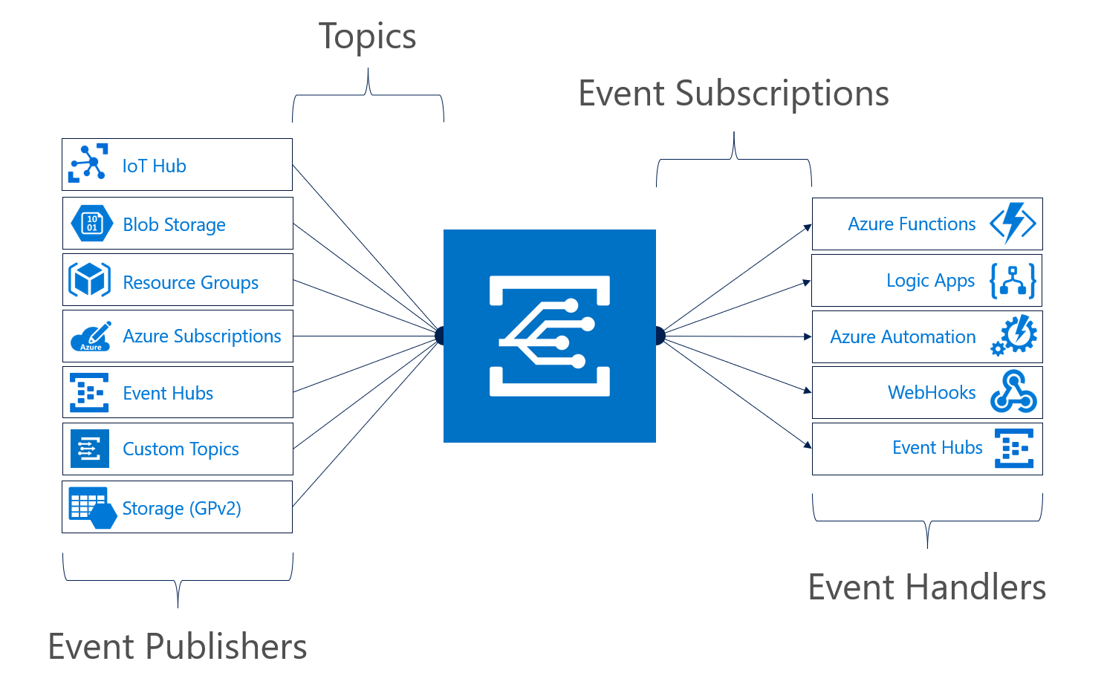
Manage all events in one place

Slide 26









Scenarios
Serverless apps
Ops automation
Third-party integration
Execute code against changes in your data store
Use a function to run a compliance check on each newly created SQL database
Use custom “drive start” and “drive end” events to log vehicle performance metrics
Trigger a function to run Cognitive API when a file is added to storage
Tag newly provisioned VMs with Azure Automation and add to metadata store
Notes:
Connect data sources and event handlers.
Speed automation and simplify policy enforcement.
Connect your app with other services.

Slide 27



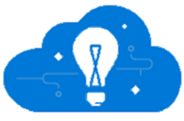
Event Hub
Event producers
Collection
Ingress
Stream Processing
Long-term storage
Presentation / action
Fast Data
Service bus
PowerBI Dashboards
Applications
Event hubs
Azure DBs
Legacy IOT (custom protocols)
Stream processing
Search and query
Cloud gateways (web APIs)
HDInsight
IP-capable systems (containers/VMs/servers)
Slow Data
Azure Storage
Cortana Analytics
Devices
Azure Data Lake
Low-power devices (RTOS)
Field gateways
Devices to take action

Slide 28
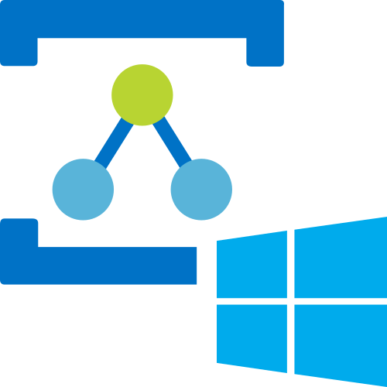
WCF Relay
One of the oldest Azure Services
WCF Relay point within a Service Bus namespace
Outbound connection from an on-premises WCF service
Uses WCF relay bindings:
Security via Shared Access Signatures (SAS)
Accessible from a variety of services & locations

Slide 29





Hybrid Connections
Connection created in Azure (Service Bus)
Hybrid Connection Manager installed on prem
Corporate Network
Microsoft SQL Server
Web App
Other published resources
Hybrid Connection
Hybrid Connection Manager
Mobile App
Hostname & Port
Hostname & Port

Slide 30

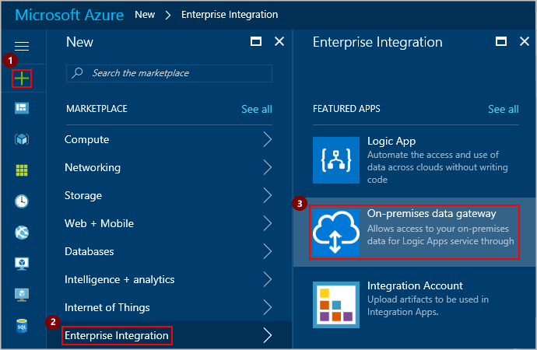
On-premises Data Management Gateway
Download and install the gateway on-premises
Create and associate a data gateway in Azure
Connect Logic App / Power App / etc to gateway
Can run over ExpressRoute
Works with connectors for Logic Apps, Power Apps, Flow & Power BI:
BizTalk Server
DB2
File System
Informix
MQ
MySQL
Oracle Database
PostgreSQL
SAP Application Server
SAP Message Server
SharePoint for HTTP only, not HTTPS
SQL Server
Teradata

Slide 31
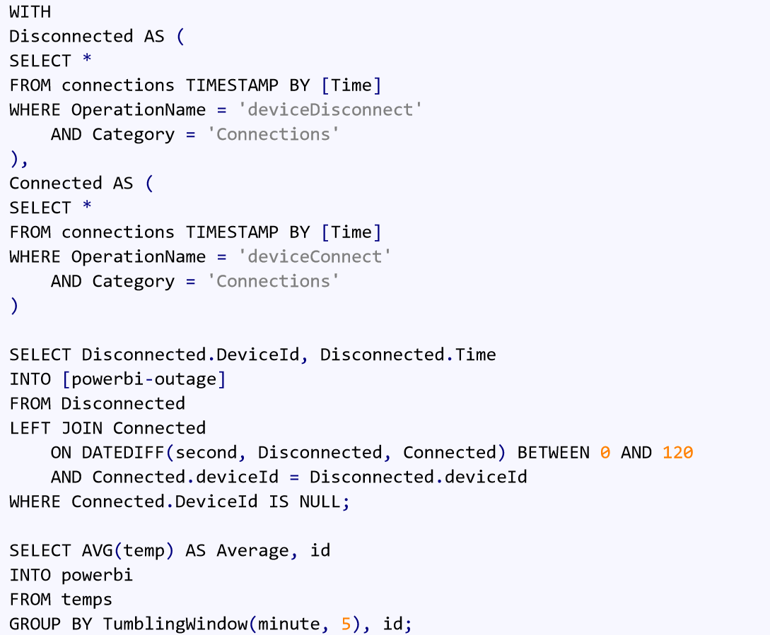
Azure Stream Analytics
Real-time stream processing
Complex Event Processing at scale
Use a subset of T-SQL with functions specific to stream processing
Perform geospatial queries
Enrich with reference data
Serverless, pay per use
Output to multiple locations, including
Service Bus
Storage
SQL Database
Azure Data Lake Store
CosmosDB
Power BI

Slide 32

Azure Data Factory
Later today!

Slide 33
Azure IoT Hub
Later today!

Slide 34
Putting it in action!

Slide 35
Further Information
Microsoft Azure Documentation
https://docs.microsoft.com/en-au/azure/#pivot=products&panel=integration
Microsoft Azure Architecture Messaging Patterns
https://docs.microsoft.com/en-us/azure/architecture/patterns/category/messaging
Integration Mondays
http://www.integrationusergroup.com/upcoming-events/
Middleware Fridays
http://www.integrationusergroup.com/middleware-friday/
Integration Down Under
https://twitter.com/integration_du

